Slide 1

ONLINE WALLET APPLICATION

Slide 2

TEAM MEMBERS :
Riya Singh
Akshat Bharara
P. Naveen
B. SaiTeja

Slide 3
Introduction
An Online Wallet is a software which allows a user to store, manipulate, and pay with various types of payment instruments.
It is a kind of a prepaid account in which user store his/her money for future transaction.
The main objective of online wallet is to make paperless transaction easier.

Slide 4

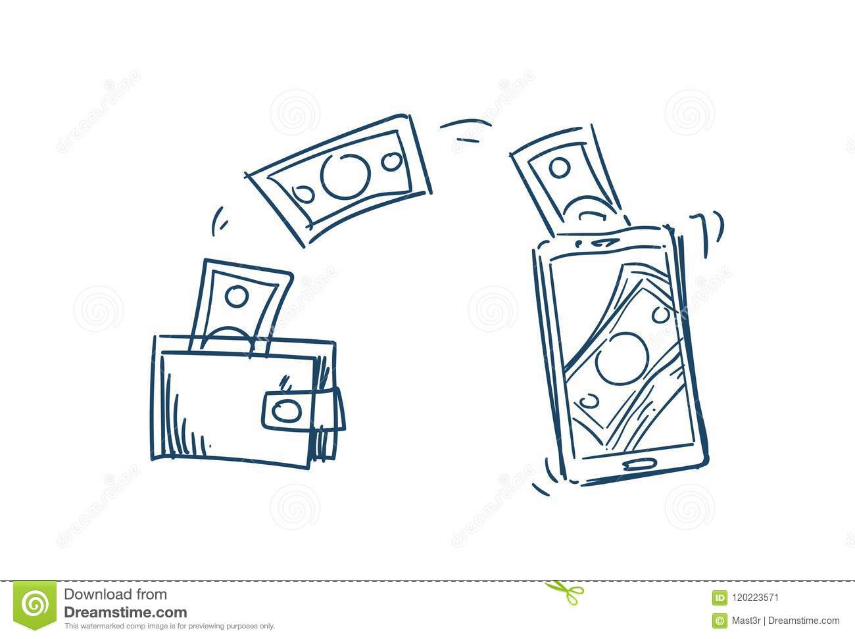


Technology Used
Spring boot for backend development.
Angular for front-end Development.
Testing of backend is done on postman.
The database is fetched by Oracle database.
Unit testing is done with JUnit testing framework.

Slide 5
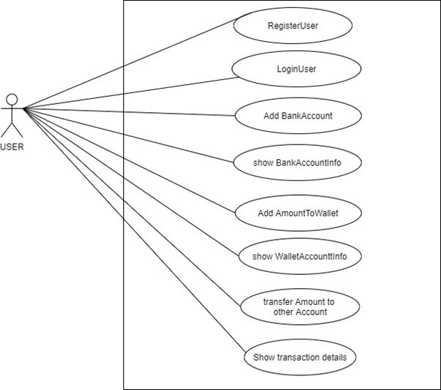
USE CASE DIAGRAM
Online wallet system

Slide 6
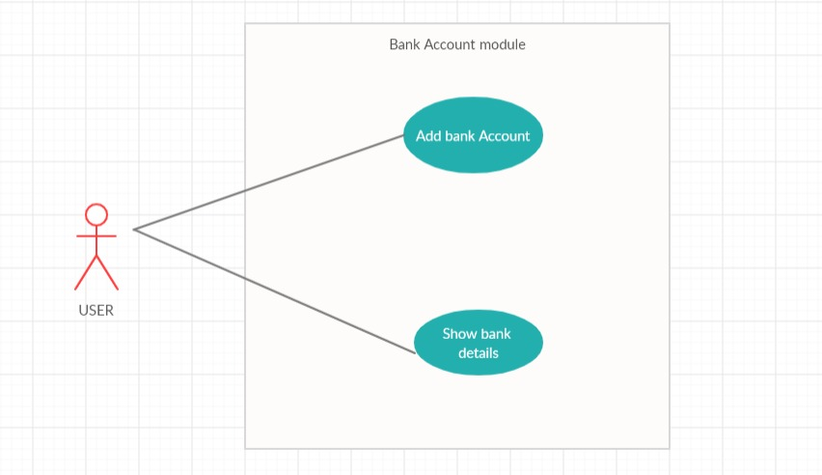
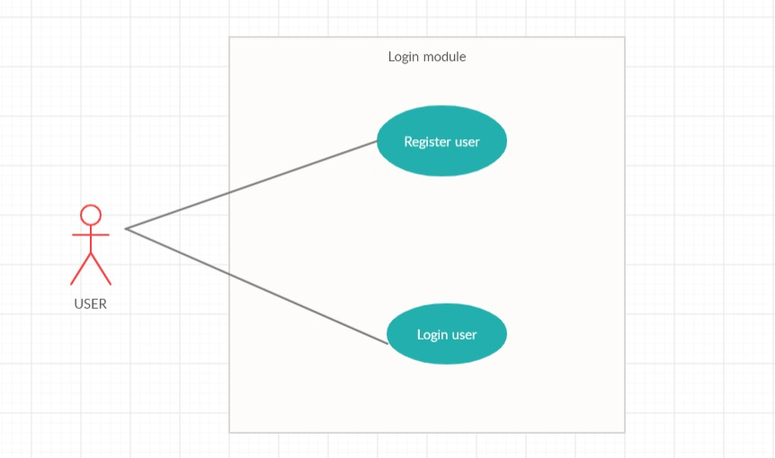
MODULE-WISE USE CASE DIAGRAM

Slide 7
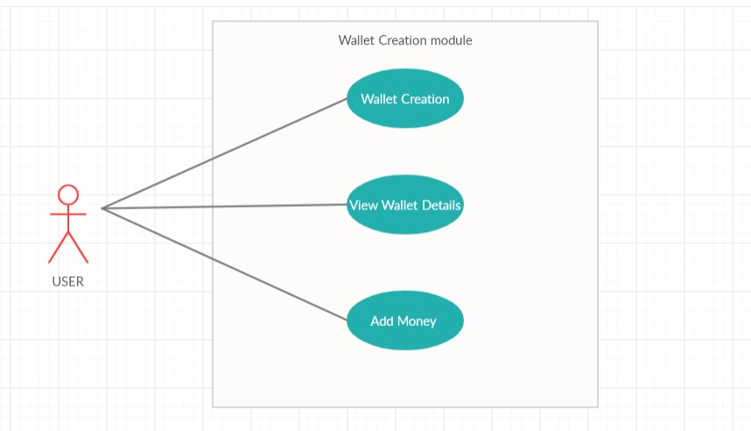
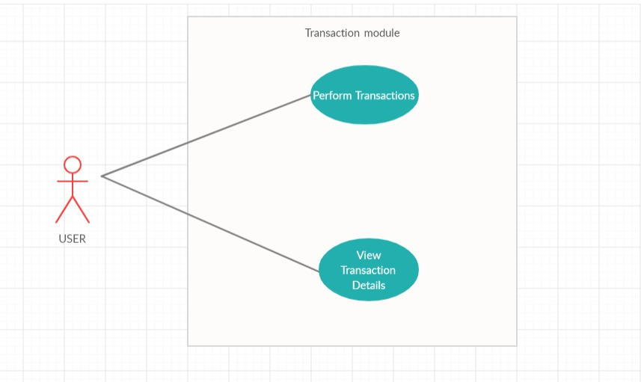
MODULE-WISE USE CASE DIAGRAM

Slide 8
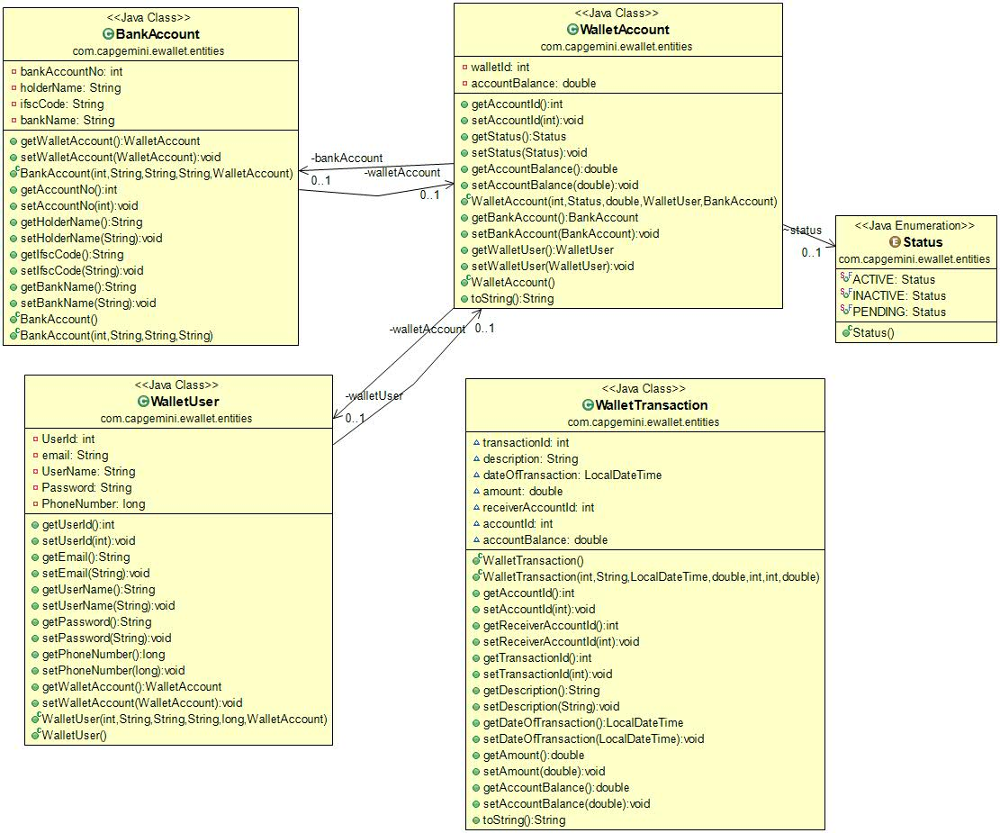
CLASS DIAGRAM
(Entity)
Online Wallet System

Slide 9
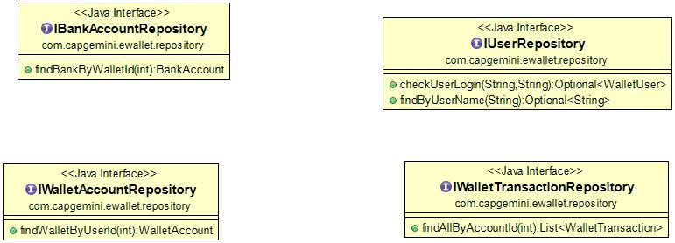
CLASS DIAGRAM
(Repository)
Online Wallet System

Slide 10
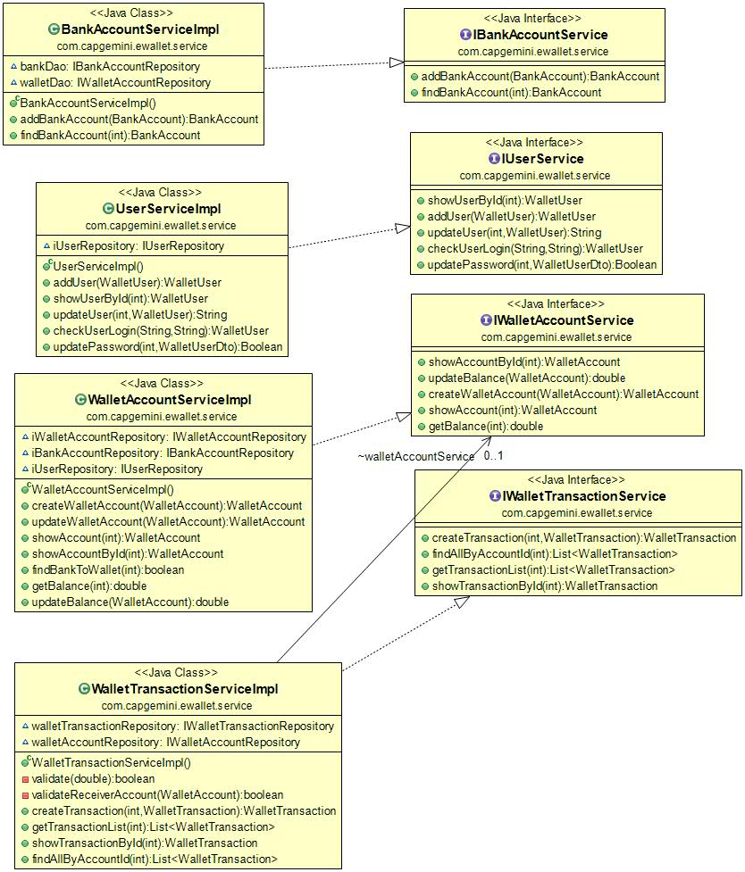
CLASS DIAGRAM
(Service)
Online Wallet System

Slide 11
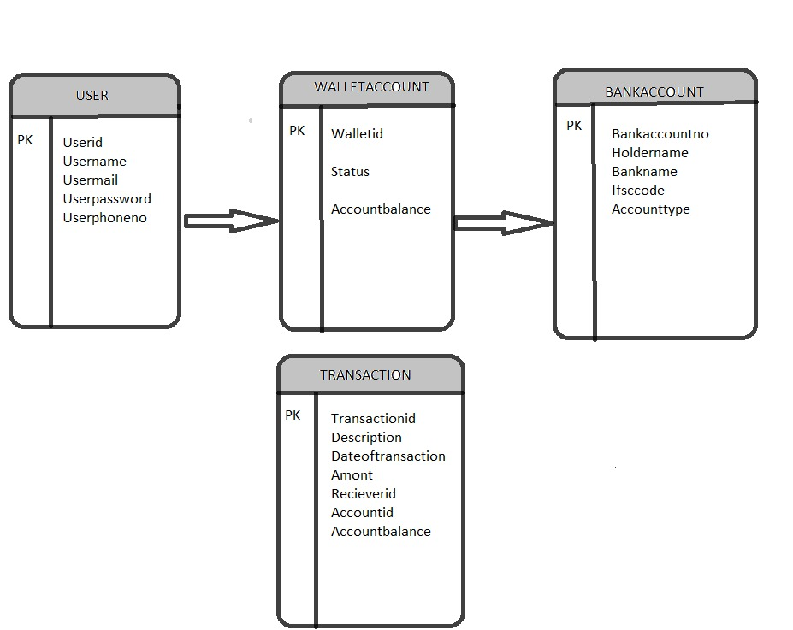
DATABASE DIAGRAM
Online Wallet System

Slide 12
Project execution
Register & Login module
Wallet Creation module
Bank Account module
Transaction module

Slide 13
Login & registration module
1. To operate the online wallet system the user has to register & then only they can login to our application.
2. At the time of registration user will be asked for the username, password and phone number
the user id has to be unique for this process.
3.After registration user directly login to the website and perform specific task.
4.For login, user needs to enter the username and password.
5.All the fields in it are mandatory to fill.

Slide 14
Wallet creation
After the registration process a wallet will be created for the registered user.
There will be a unique wallet id which will be provided to the user.
This wallet ID will be used for further transactions
The wallet id plays important role for performing different operations.

Slide 15
Adding bank details
1. After registration user can link his/her bank account to their online wallet.
2. Fields required for this process are
->Account holder name
->IFSC code
->Bank name
3. Bank link to the wallet is important to do the further task.
4. Other functionality works only if the bank account is link to the wallet.

Slide 16

Adding money to wallet
1. After the linking of the bank account the money can be added to the wallet.
2. Without linking of the bank account this functionality will not work.
3. It is one of the easiest way to add money to wallet.
4. Money is added from the bank to the wallet.
5. Balance is updated accordingly.

Slide 17
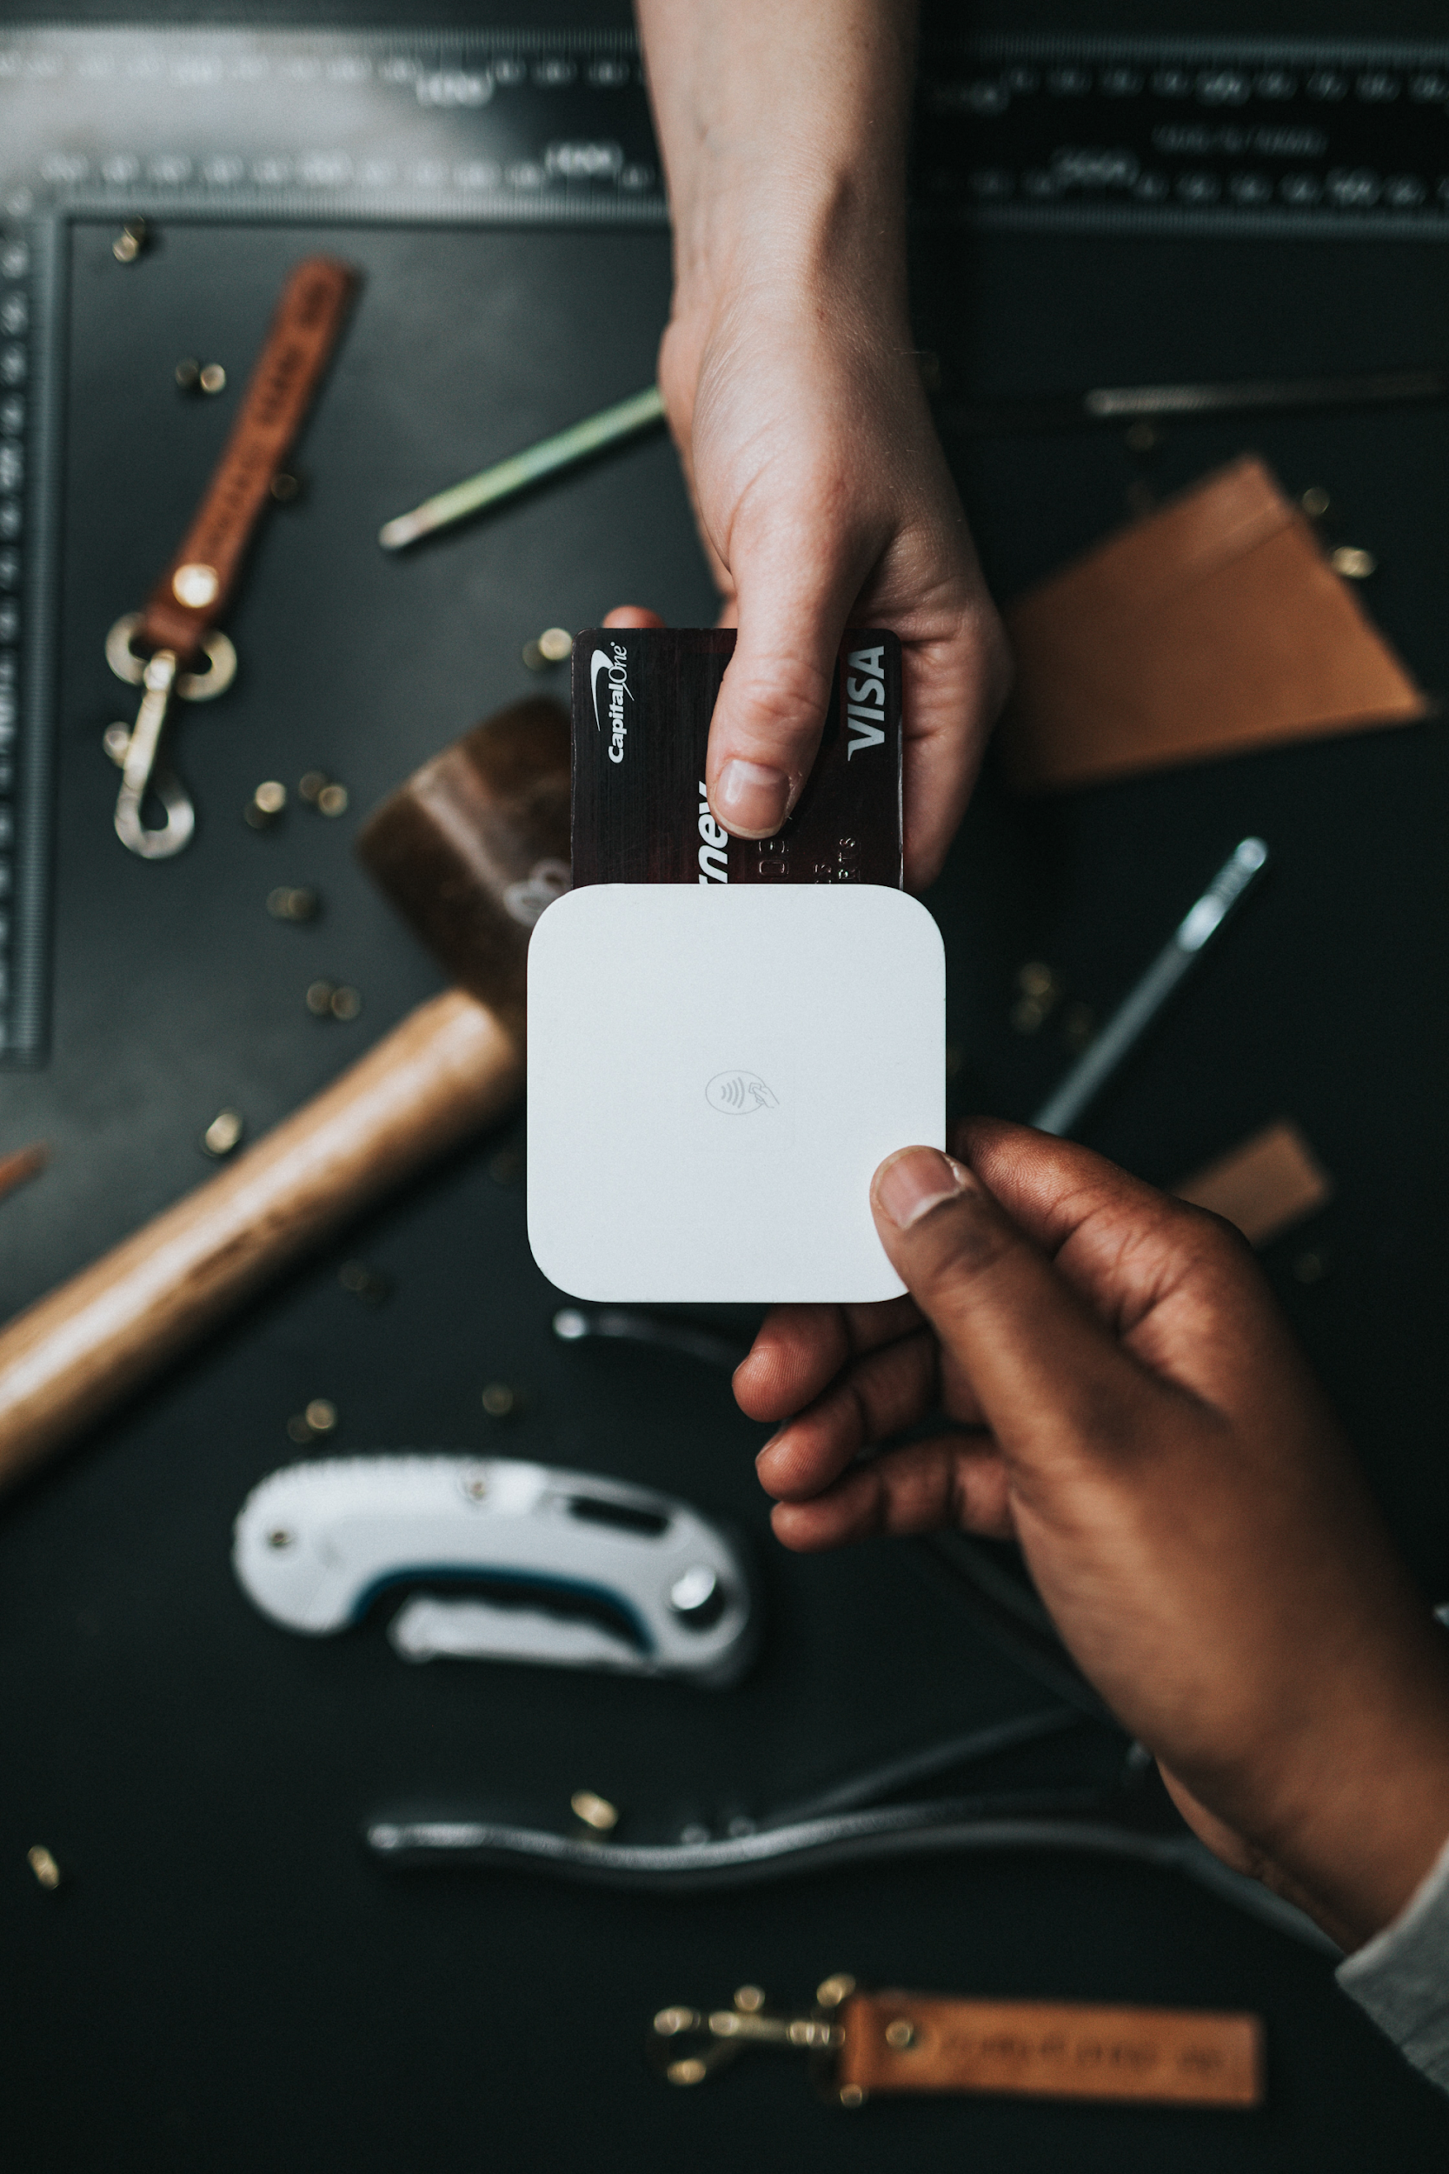
Transaction
1. Money can be transferred from one account to the other account with the help of the unique wallet id’s of both the accounts.
2.Transaction can be either financial, business or payment.
3.Wallet id is important during the transaction.
4. For this, user has to enter amount to be transferred and receiver wallet id to transfer the money.

Slide 18
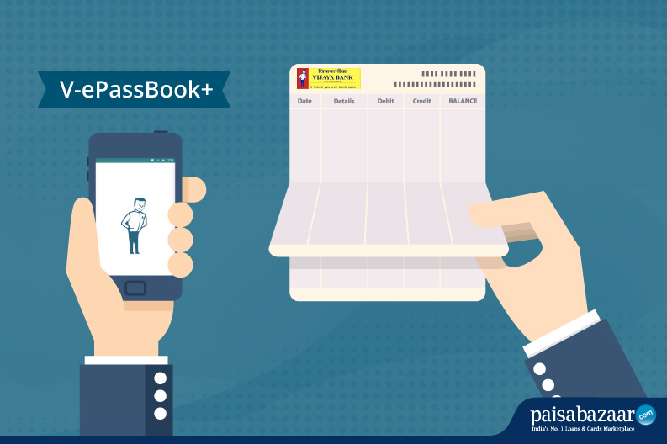
Passbook
This module shows all the details of wallet and transactions.
All the details related to transaction like balance, date of transaction, amount transferred , transaction id.
It will help the user to know about the details related to the wallet.

Slide 19
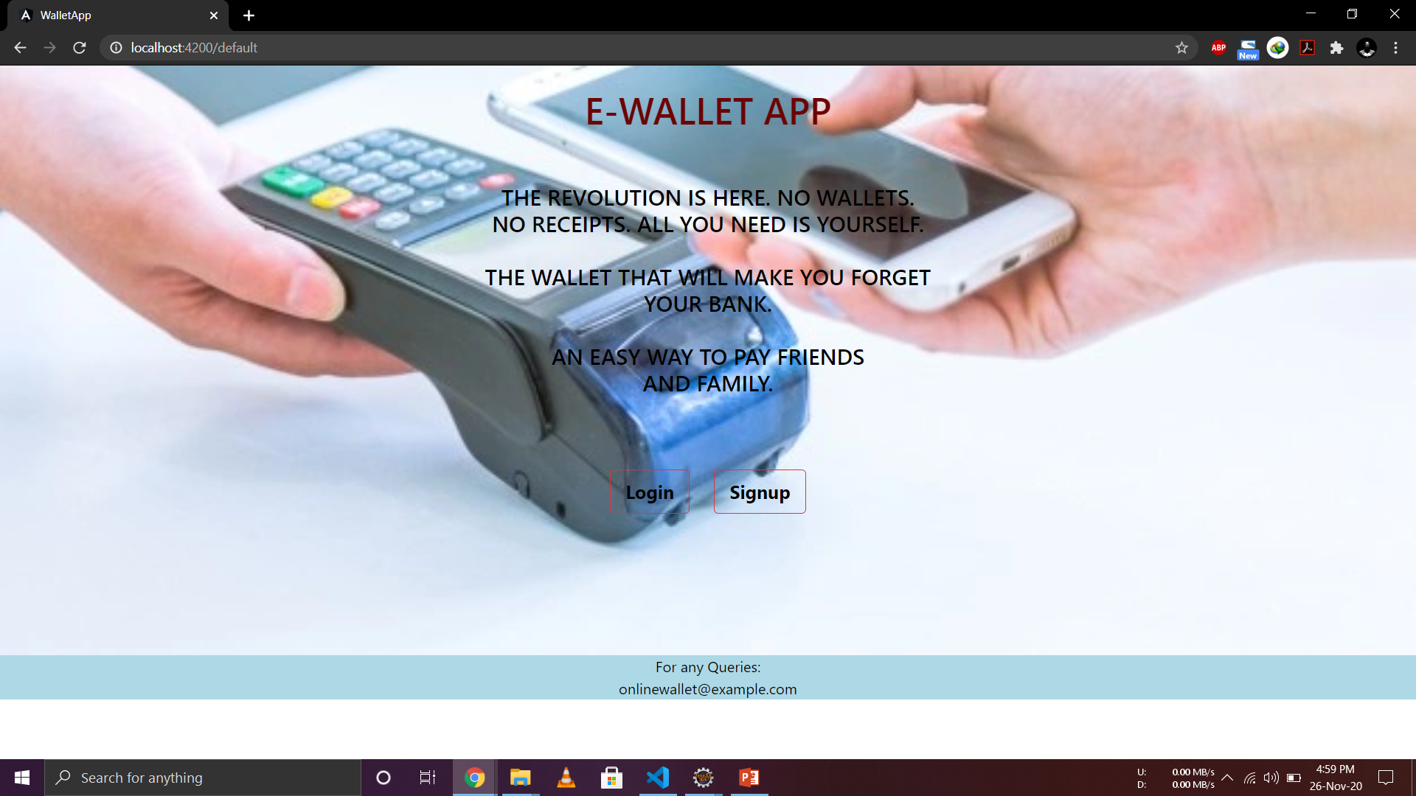
Screenshots
Landing Page

Slide 20
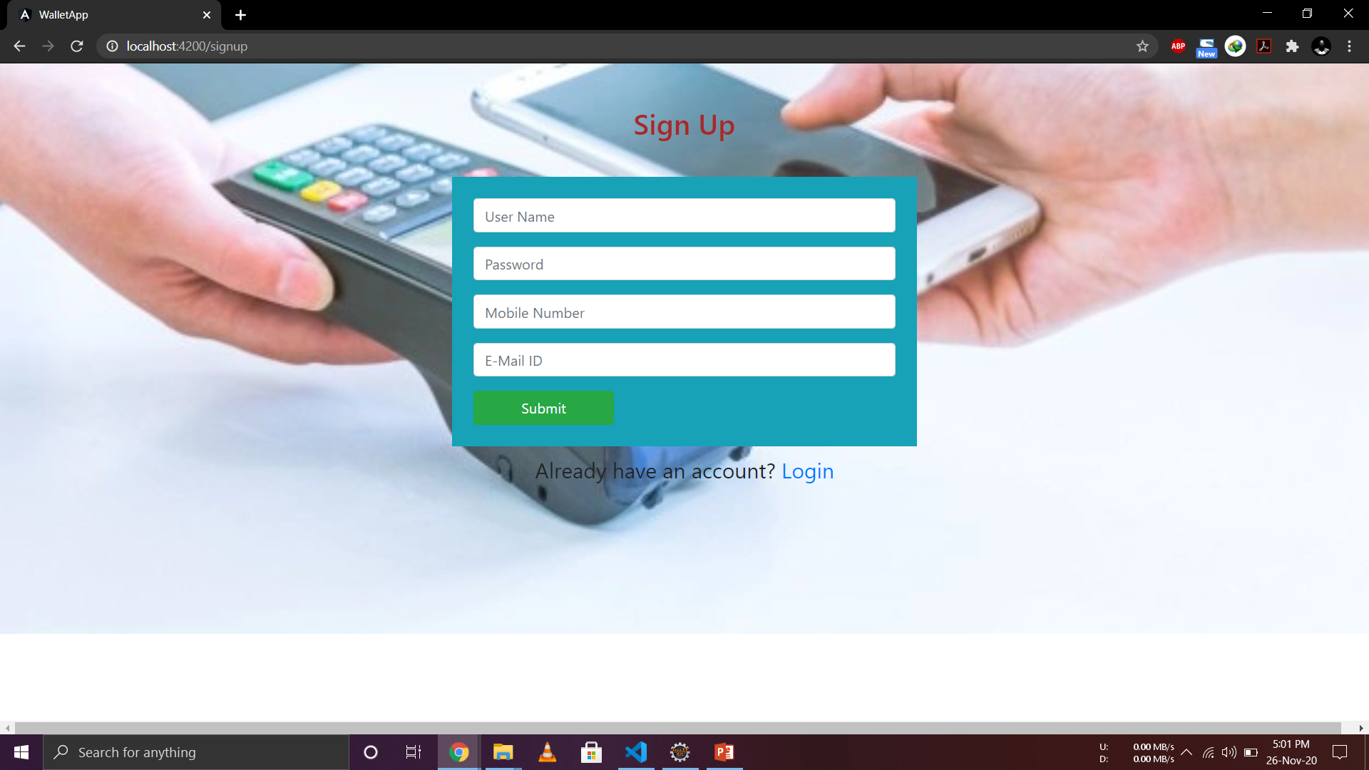
Screenshots
Sign Up Page

Slide 21
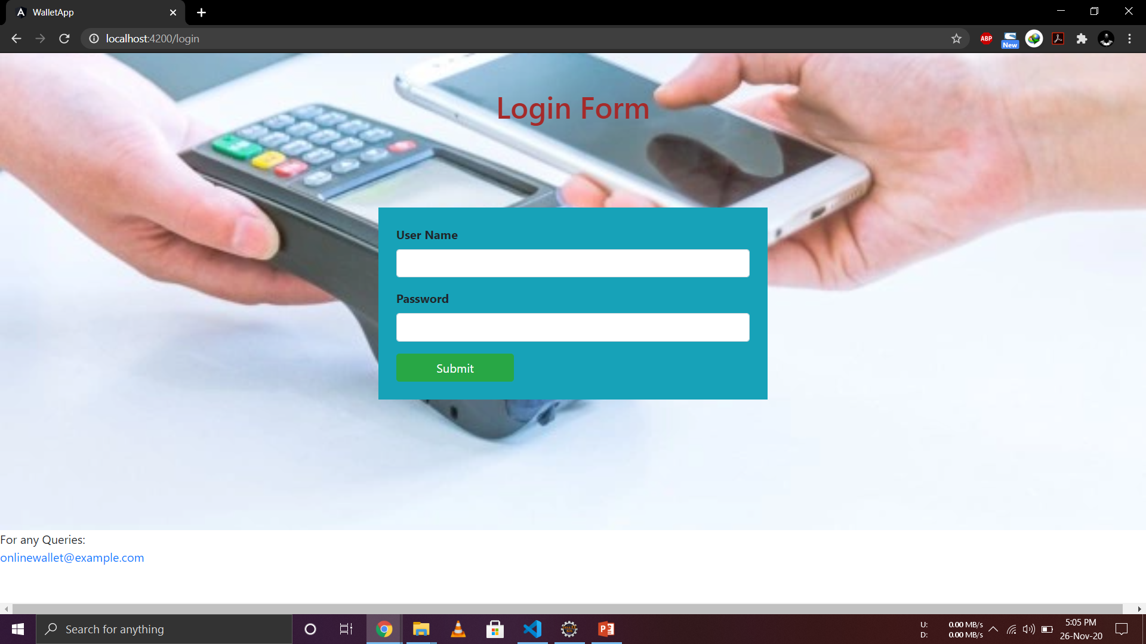
Screenshots
Login Page

Slide 22
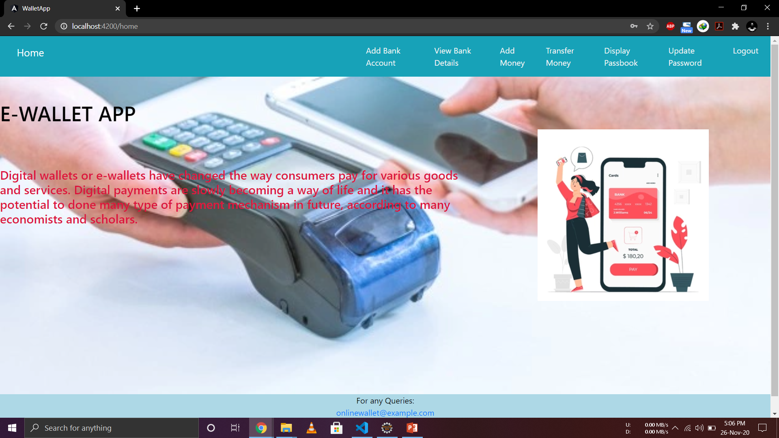
Screenshots
Online Wallet’s Dashboard

Slide 23
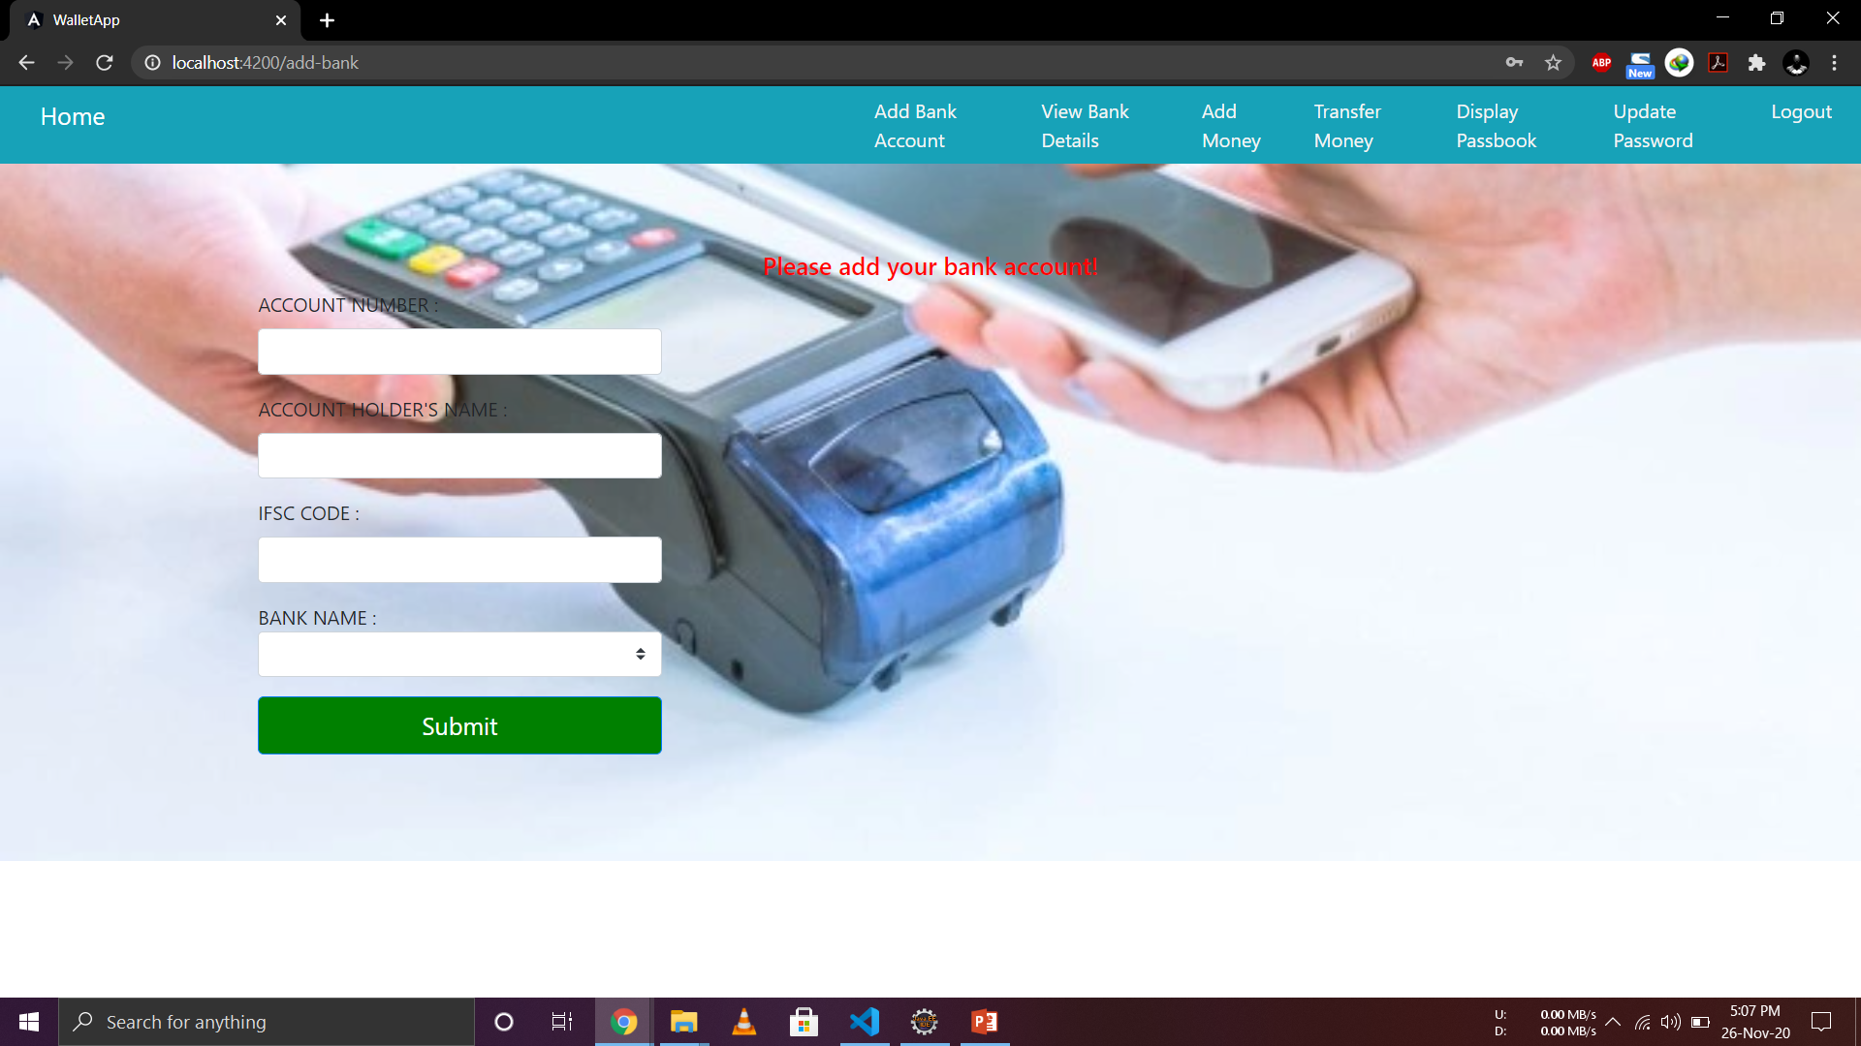
Screenshots
Add Bank Account Page

Slide 24
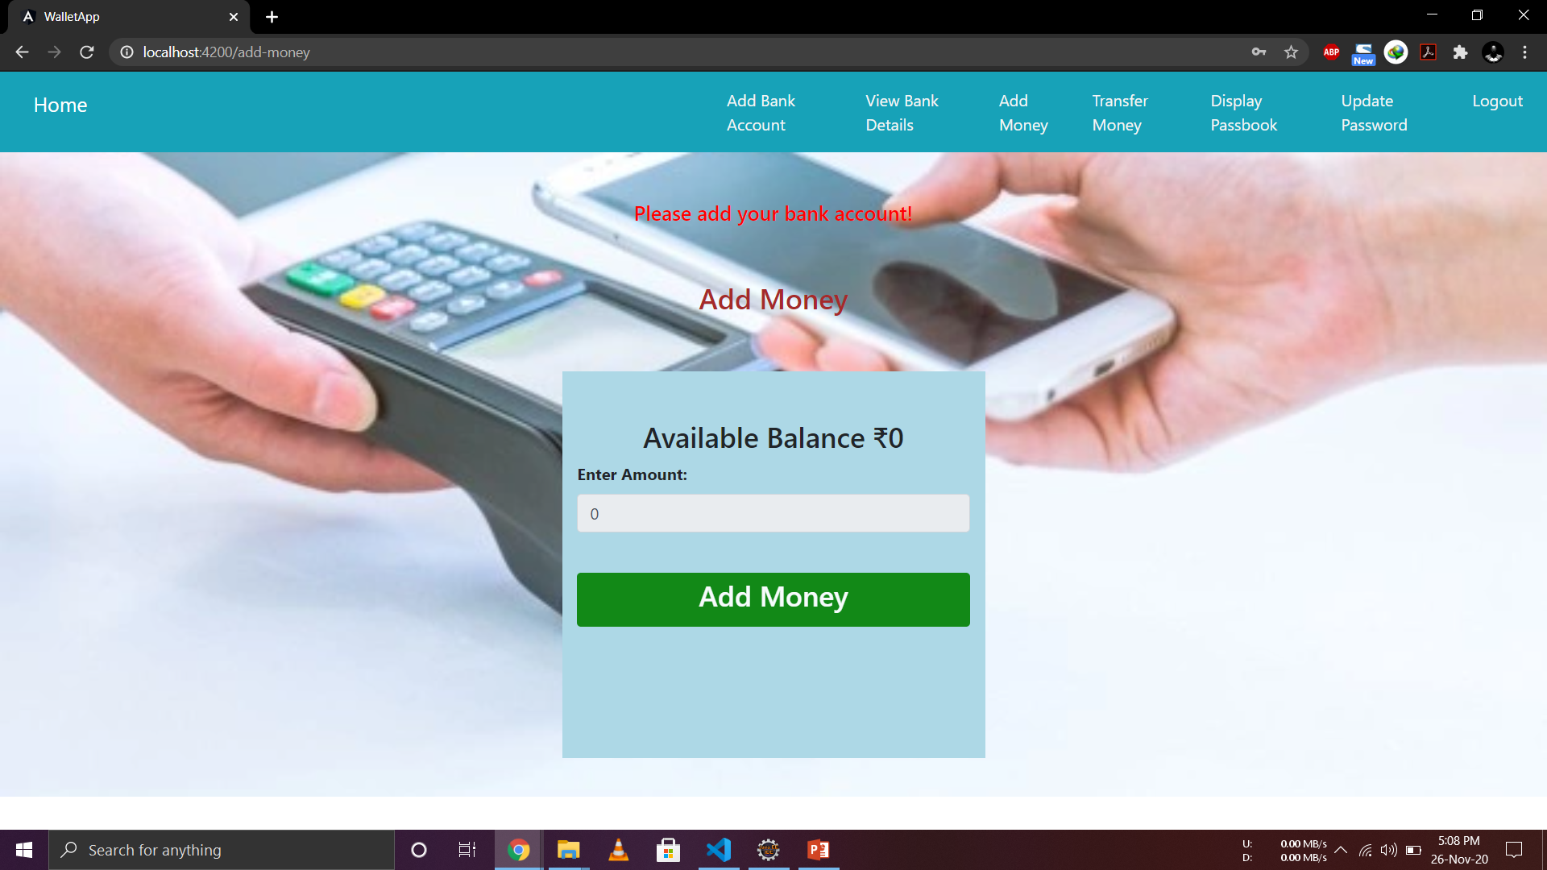
Screenshots
Add Money to the Wallet

Slide 25
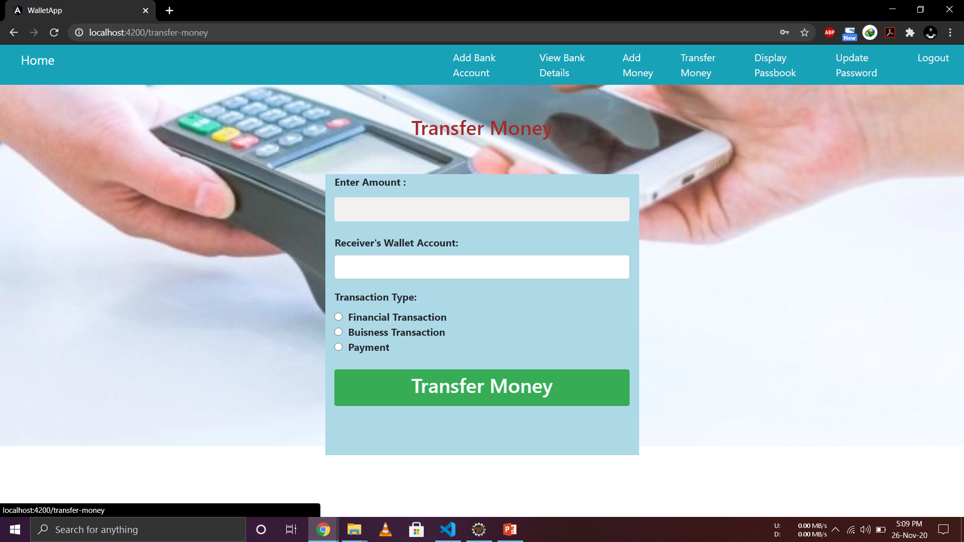
Screenshots
Transfer Money

Slide 26
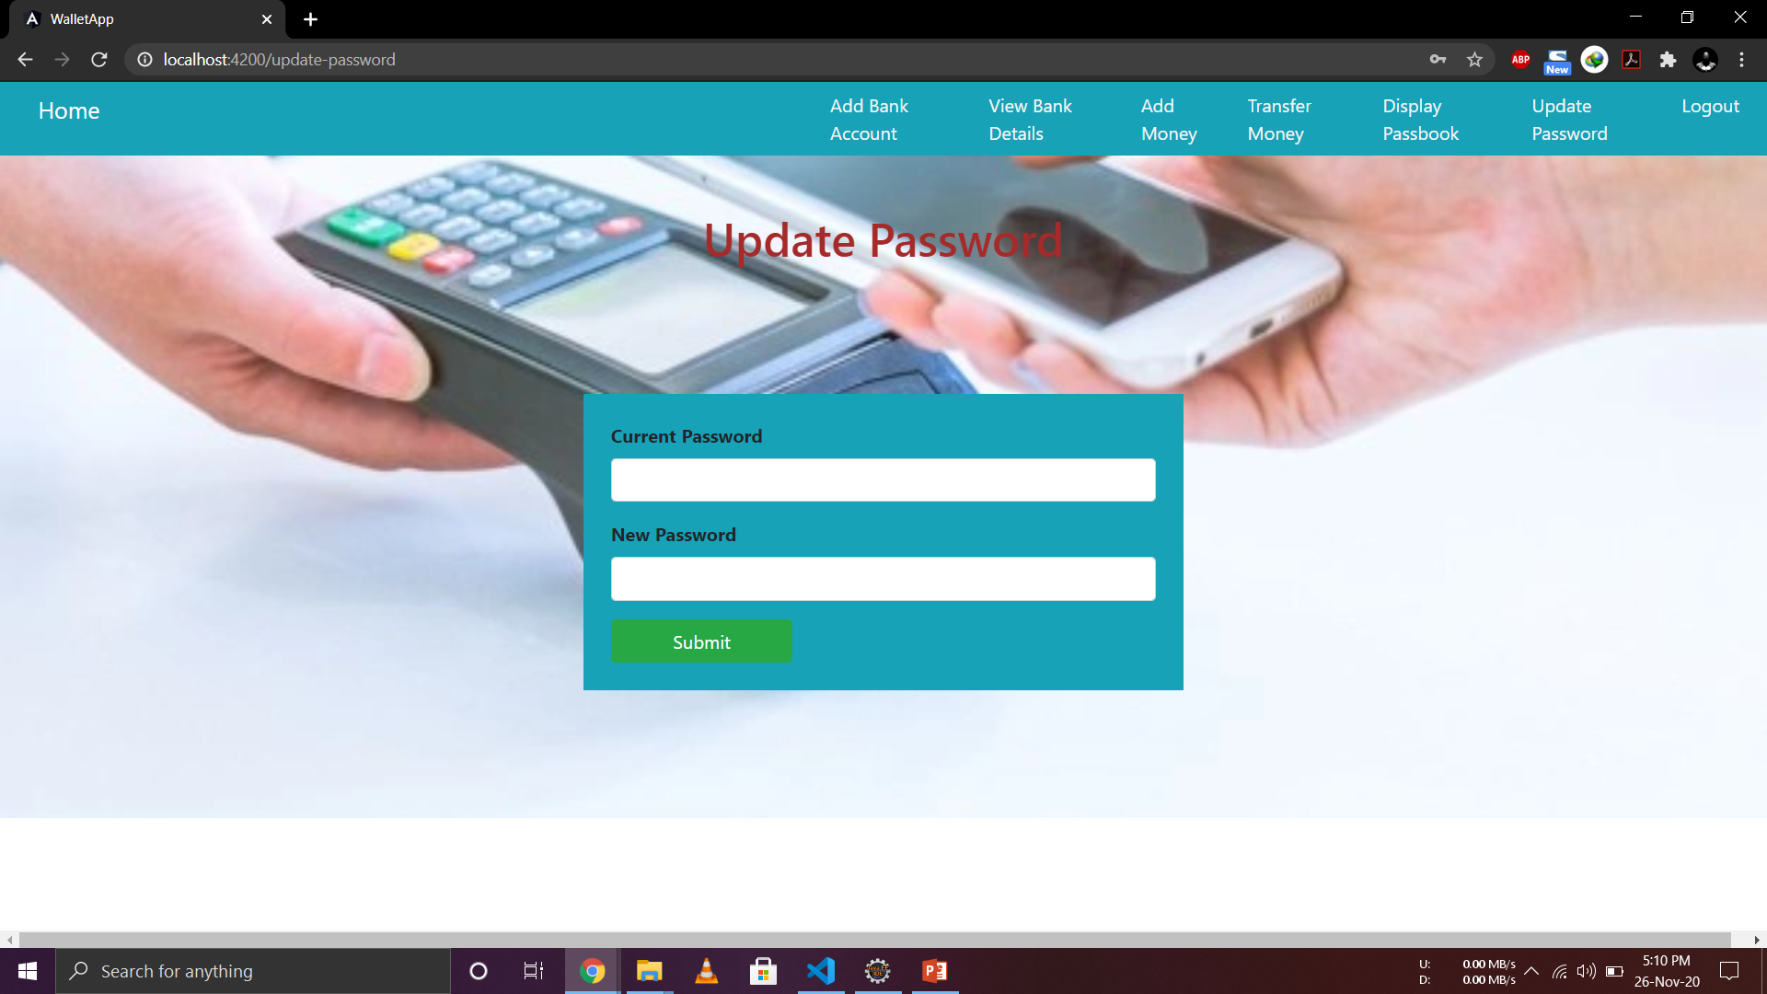
Screenshots
Update Password

Slide 27
Best Practices
Followed placing comments in appropriate places
Followed naming conventions.
Followed proper indentation.

Slide 28
Learnings
We have implemented the Online Wallet, using Spring boot framework with JPA and Angular.
We have learned to work as a team.
Time Management and division of work.
Supporting team members in the work.

Slide 29
Thank you....

